Slide 1

Drone Networking
Firewall Force
Connor Plonka, Nicholas Paceski, Andrew Destacamento, Lazaro Loureiro, Samson Silver, Richardson Jacques
Mentor: Nicholas Taylor

Slide 2
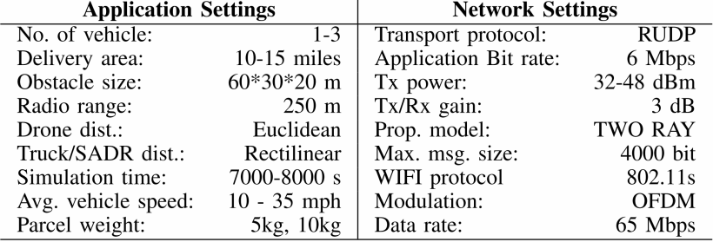
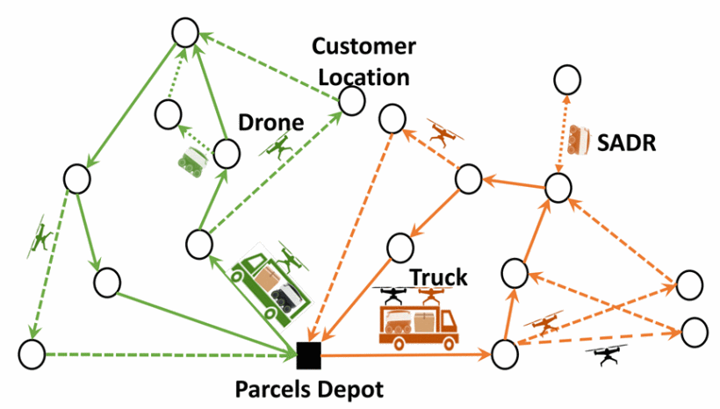
Context
Network of delivery trucks, sidewalk autonomous delivery robots (SADRs), and drones.
Trucks have a mesh WiFi system
SADRs and drones connect to truck WiFi
Truck WiFi connect to Ground Control Station (GCS)
Based on “Environmentally-Aware Robotic Vehicle Networks Routing Computation for Last-mile Deliveries” by Qu et al. (2023)
2023 32nd International Conference on Computer Communications and Networks (ICCCN)
Department of Electrical Engineering and Computer Science, University of Missouri - Columbia, USA
No actual drones, SADRs, or routers available

Slide 3

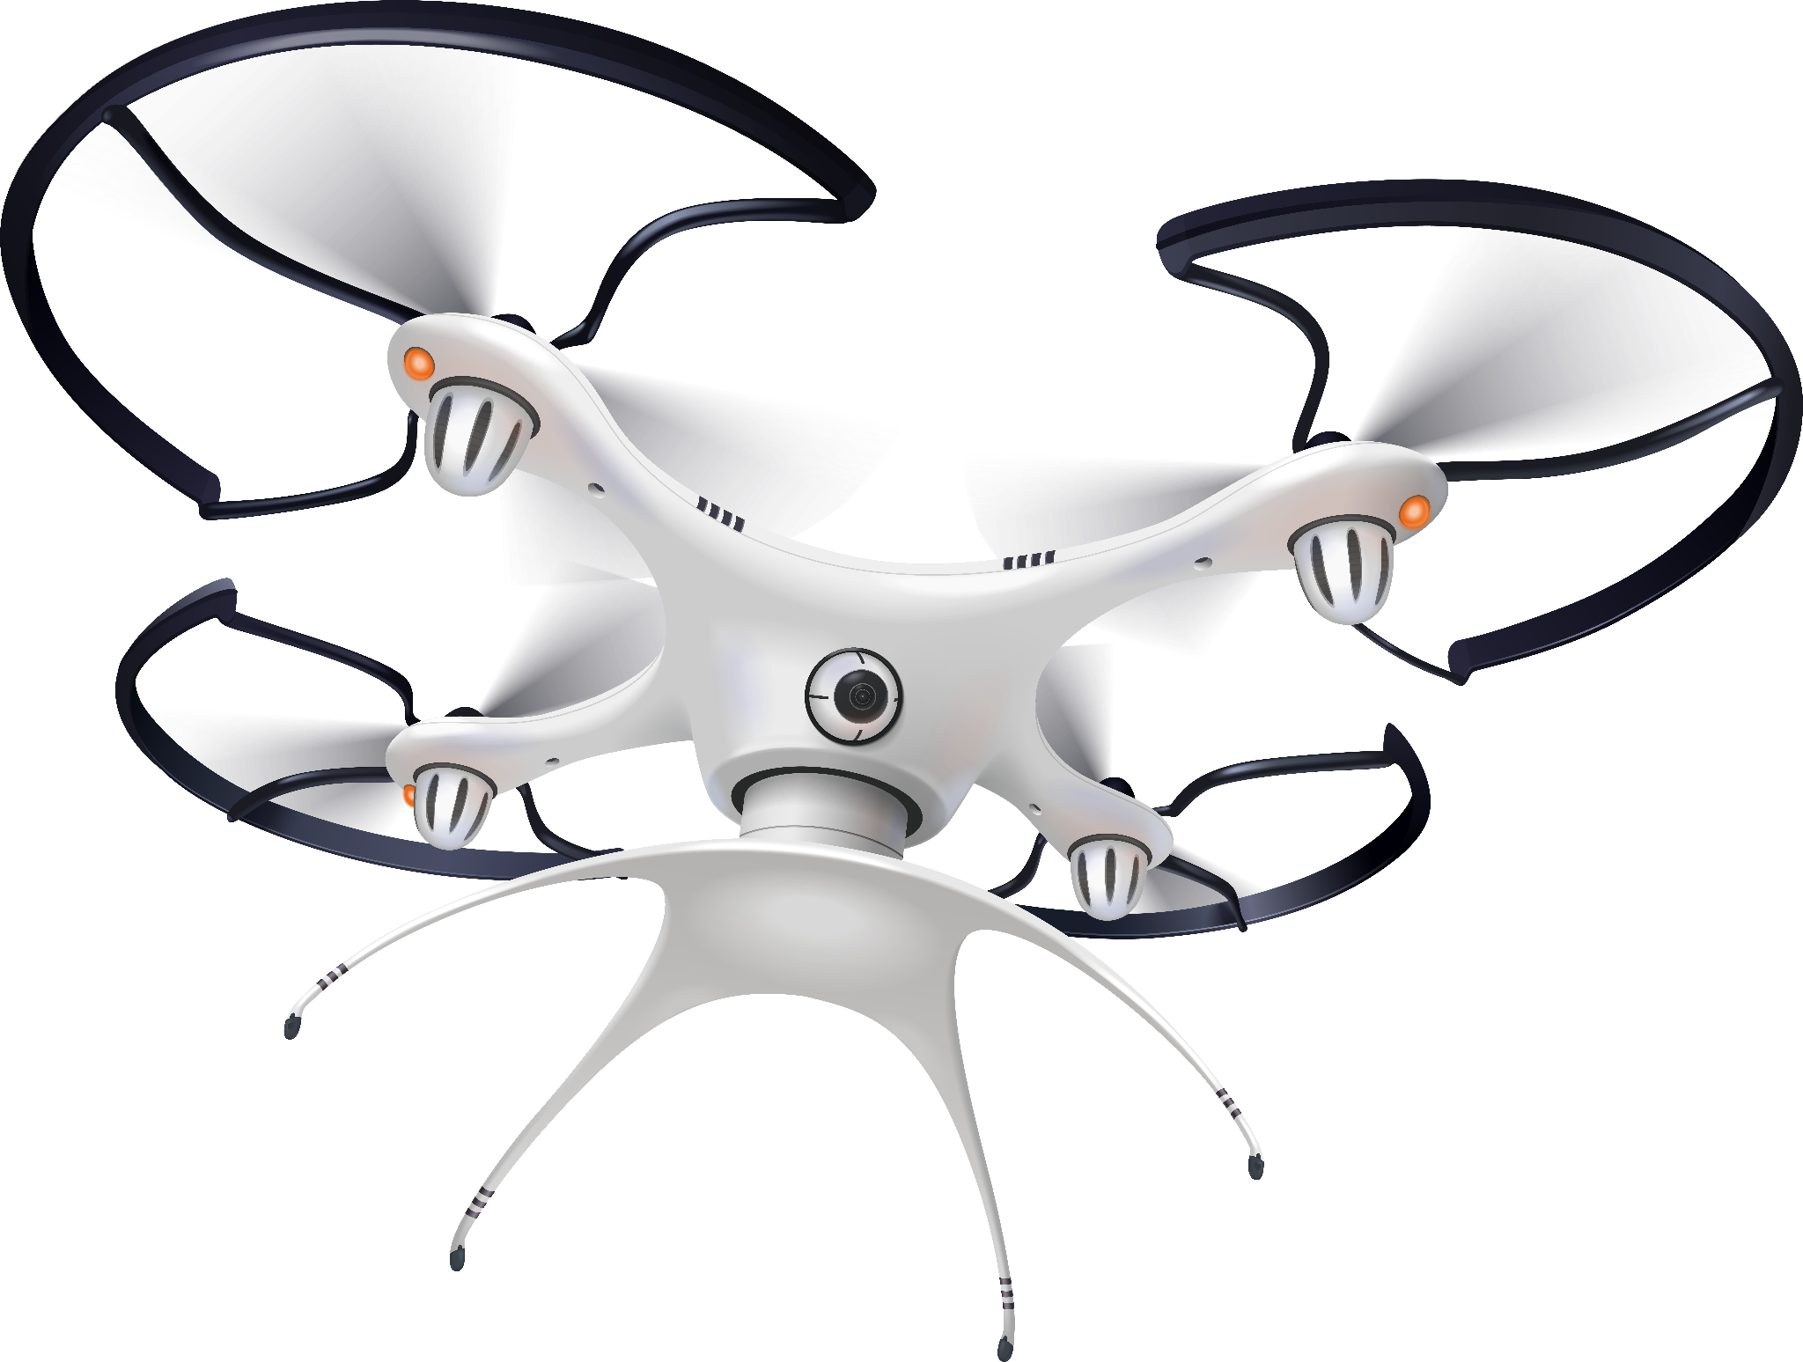
Overview
We’ve chosen to work on the security aspects of drone networking, creating a system in which the drones themselves and the network they run on are protected from attacks.
We plan to protect the network through various means, such as:
IP/MAC Address Rotation
WPA3 Authentication
Rate Limiting
Flooding Prevention
And others

Slide 4

Implementation Details
‹#›
01
IP and MAC rotation
Randomized, but valid, IP and MAC address renewal
04
WPA3 Authentication
RADIUS server w/o a central authentication point
Hacking prevention measures
02
Rate Limiting & Authentication Flooding Prevention
Secure secret password between truck and drones.
Encrypted tokens for authenticated drones.
05
Firewall Defense
03
Secure P2P Networking
VXLAN over IPSec

Slide 5
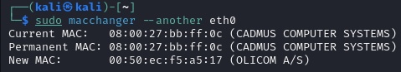
IP and MAC rotation
IP address randomization (e.g. 192.168.100.100 → 192.168.100.112)
Handled by truck WiFi, depending on router firmware
Solution assumes dnsmasq is used, such as in OpenWrt
Proposed solution: Instructions on how to set up dnsmasq for randomization
MAC address randomization (e.g. 08:00:27:bb:ff:0c → 00:50:ec:f5:a5:17)
Handled by device firmware
Solution assumes a Debian-based firmware
Proposed solution: systemd service, uses GNU macchanger package
macchanger does not disconnect from network
Rotation:
Average simulated delivery drone deploy time is about 2 hours
Allow user to edit rotation timings
IP: DHCP lease time (2 minutes to 60 minutes, unspecified)
MAC: service script sleep command (3 minutes to 13 minutes, random)

Slide 6
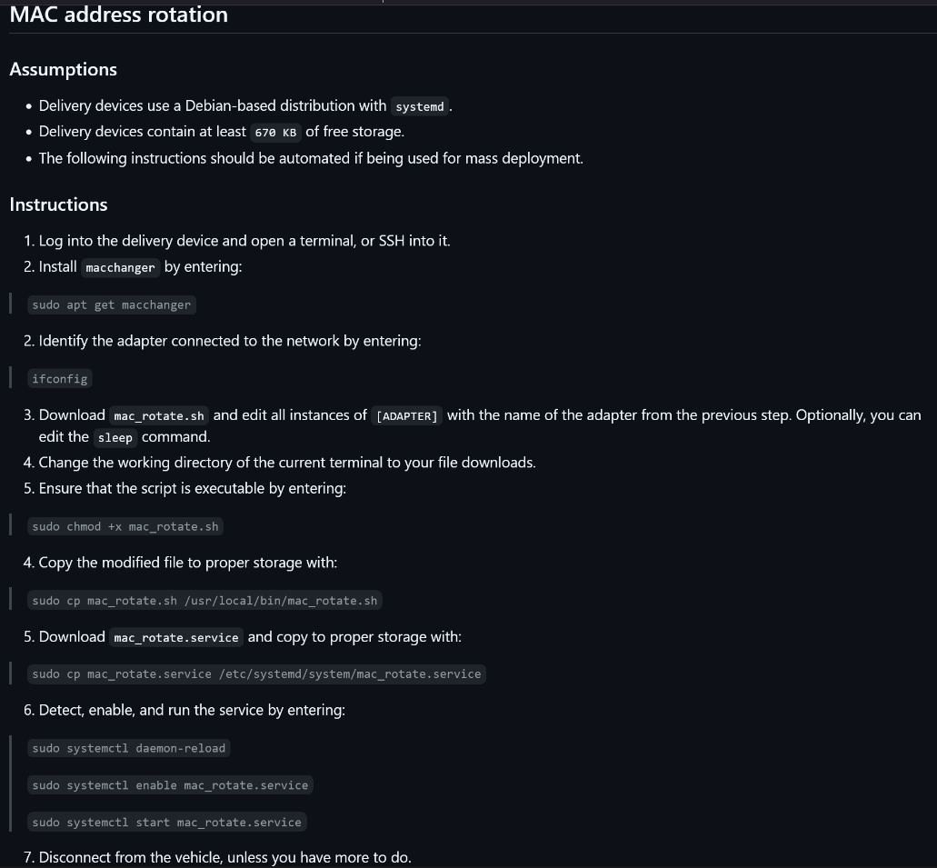
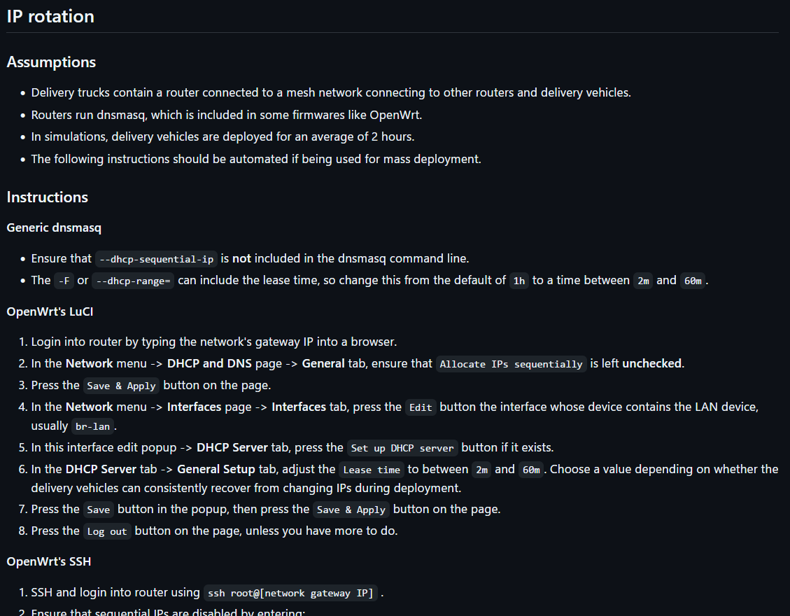

Slide 7
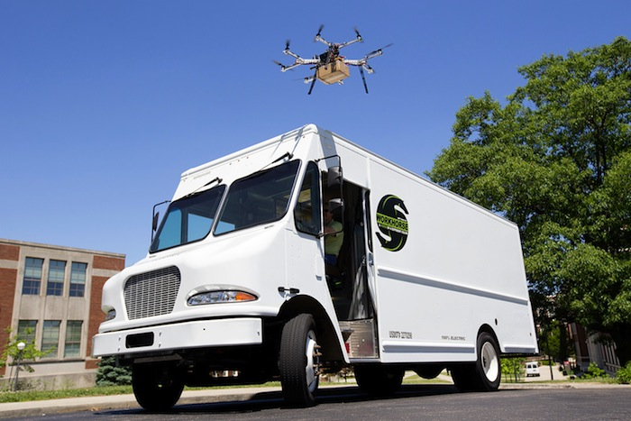
Rate Limiting & Flooding Prevention
Static drone IP’s, Dynamic tokens
Truck
Drone
Secure key only shared with the truck and the drones.
Store drone IP to to track attempts and prevent flooding.
Generate hashed token using the secure key (HMAC).
Authenticate with drone by sending POST requests using token generated (send data to a server).
Verify that the token generated by the truck is the same as the drone.
If token matches, authentication succeeds and any command sent from truck is ran.
Authentication request to the truck takes drone IP and validates the token.

Slide 8
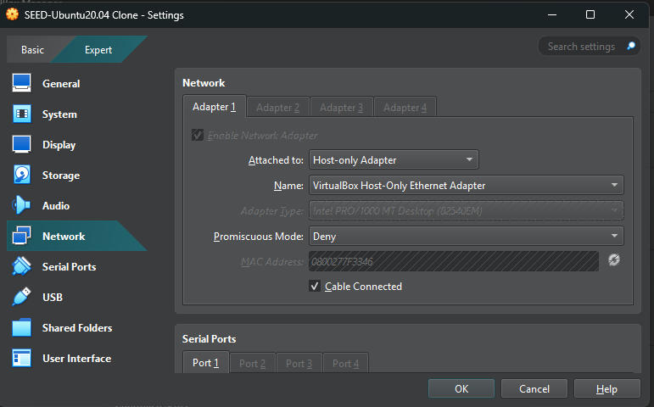
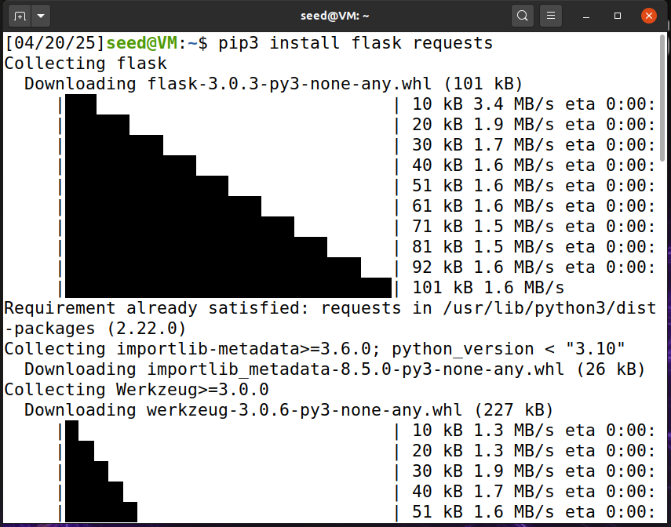
Rate Limiting & Flooding Prevention
Static drone IP’s, Dynamic tokens (SIMULATION)
The truck and drone simulations take place in Ubuntu VM.
Using 2 Network adapters for the VM’s, one bridged to physical LAN and second as a host-only adapter.
This simulates the connection of drone to truck.
Installed flask requests on both VMs to simulate server requests.

Slide 9
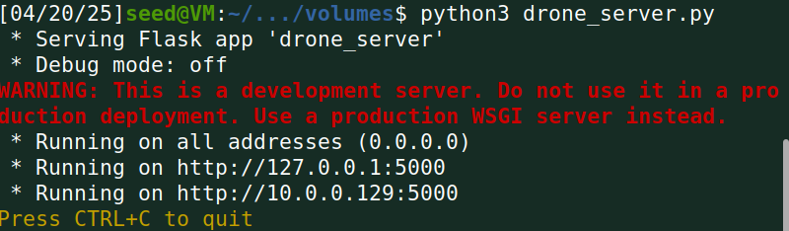
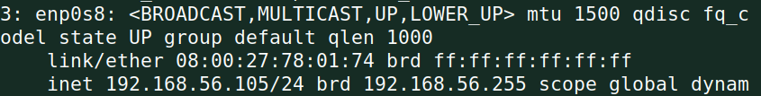
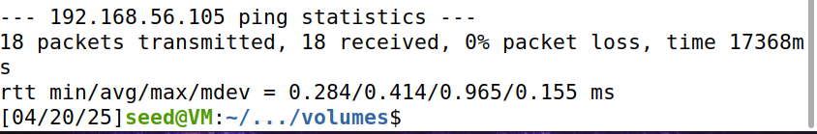
Ran drone_server.py on the drone VM.
Ran “ip a” terminal command to get drone IP to add to truck_controller.py.
Pinged drone on truck to show connection.

Slide 10
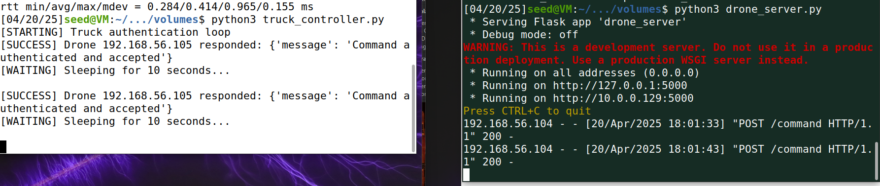
I ran the respective scripts on both VMs (truck and drone).
The drone server is receiving flask requests to authenticate with the truck controller.
This allows the truck to send whatever commands to an authenticated drone.
After authenticating, the truck will wait a number of seconds before trying to authenticate with the drone again.

Slide 11
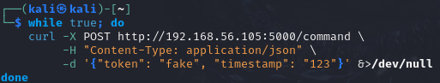
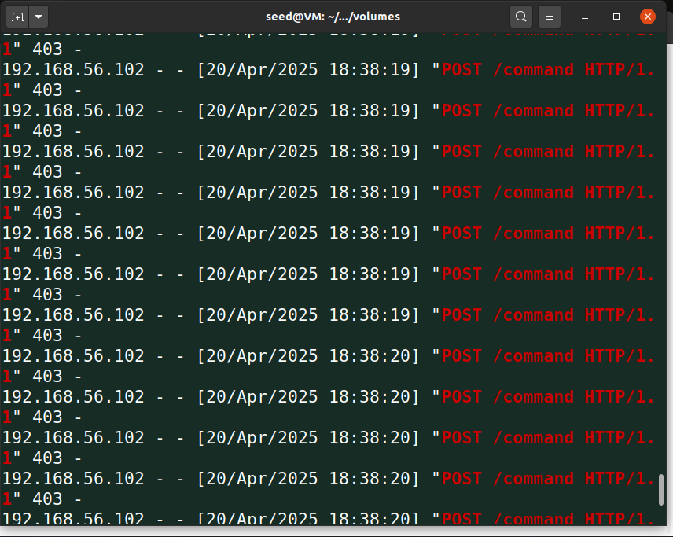
Here I attempted flooding the drone_server by repeatedly sending fake requests to the drone.
These attempts were unsuccessful in authenticating with the drone. This shows how the truck is the only one allowed to send commands to the drones.

Slide 12
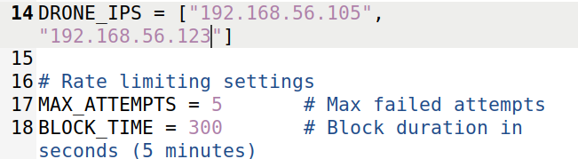
I will add an unused IP address to the truck controller list of trusted drone IPs. This IP will simulate a ‘misbehaving’ drone that is not authenticating properly.
Once running the truck_controller and it starts authenticating with the drone IPs, it will track and block for any failed attempts.

Slide 13
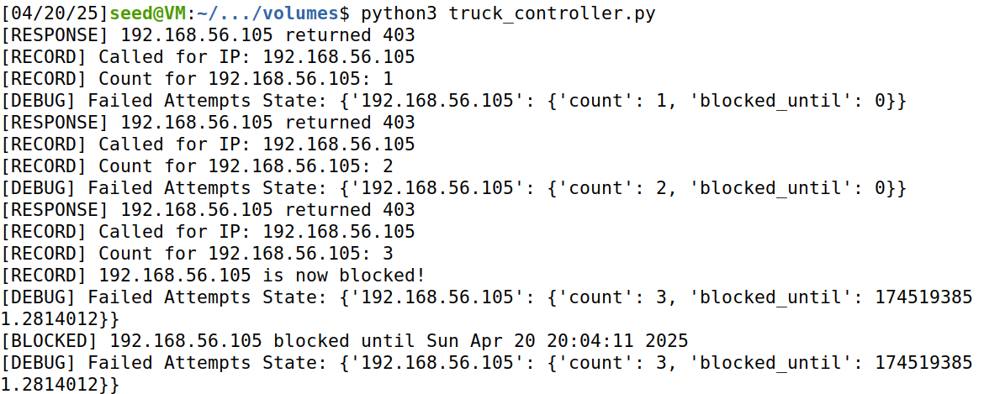
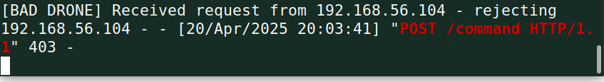
Ran a “bad drone” script to try to flood the truck controller. The attempts were tracked and blocked after so many tries.

Slide 14
Rate Limiting & Flooding Prevention
Dynamic drone IP’s, static tokens
Truck
Drone
Manually give truck drone(s) starting IP’s
Store drone IP’s with their respective token (stored in a JSON file).
When drone sends an authentication request with truck, if the token is correct but the IP is different, it will authenticate successfully and update the drone’s IP.
If the IP is the same and token is different, it will fail authentication.
Each drone will generate their own secure token (stored in a JSON file).
Drone sends IP and token at run time to truck to store.
IP changes within a given timeframe from MAC rotation.
Authentication with truck will run and new IP will replace old IP if token is correct.
Due to time constraints and team members being at different checkpoints in the project, I was unable to test the dynamic components of authentication and flooding. I was able to get the scripts written but they have not been tested.

Slide 15
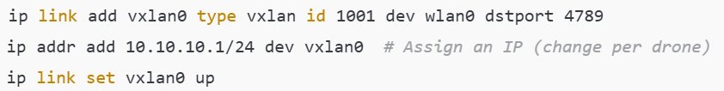
Secure P2P Networking
For secure P2P networking, the drones will use VXLAN over IPSec
Ensures unencrypted traffic does not enter or leave the tunnel
Setting up VXLAN tunnel:
strongSwan will be used to configure the IPSec connection
Notes:
strongSwan is a Linux tool used for establishing secure connections

Slide 16
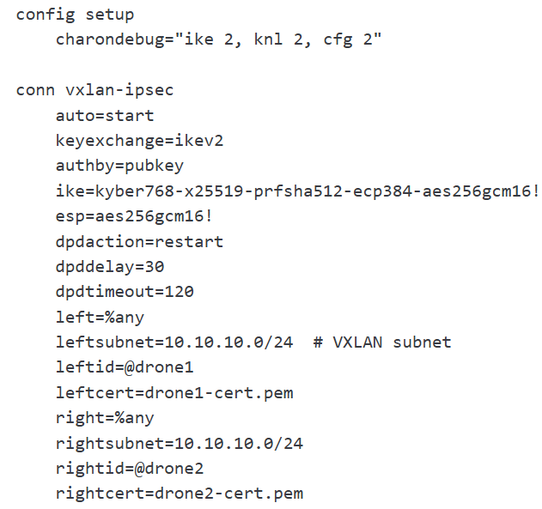
IPSec Configuration
IKEv2 is used for a secure exchange of keys
Uses certificates
Kyber768 + X25519 key exchange
AES-GCM-256 cipher
Penetration testing will be used to make sure the VXLAN tunnel is indeed secure
Sniffing attack- attacker should only receive unreadable esp ciphertext
Man in the middle spoofing attack- drones should drop any and all packets that are not encrypted and authenticated
Notes:
Certificates are better than PSK (Pre-shared keys)
Kyber768 + X25519 key exchange protects information against a quantum attack

Slide 17
WPA3 Authentication
WPA3 (WiFi Protected Access) authentication is a security standard from the Wi-Fi Alliance
This system in particular uses a RADIUS server (Remote Authentication Dial-In User Service) without any central authentication point
W/O a central authentication point the server would instead rely on a local authentication database or other methods if needed.
The system simulates a WPA3-Enterprise using TLS+X.509 between the drone and control server
Authentication is locally enforced with Zero Trust principles, instead of a traditional RADIUS server
Each drone would be verified by certificate signatures, expiration, issuer, and the assigned role
Notes:
Faced an issue where the certificate verification started to fail as it was trying to get access from an expired certificate.

Slide 18
Firewall Implementation
Created firewall settings for the drone and truck so that a truck can only accept a connection from an IP address of a valid drone, and only to a specific port. The drone’s firewall is also set to only accept traffic from the IP address of the truck, and only from a verified port.
Was not able to implement the zero-policy encryption, due to not finding good materials teaching how to implement
Notes:
Only accept messages from registers drones and the truck IP.
Encryption for messages shared key or certificates no eavesdropping.
Keep every part isolated so one drone doesn’t compromise whole system
With WPA# authenticated,encrypted, and locked behind firewalls with 0 trust.
access control: drones can only perform specific authorized actions. If a drone tries to do something it’s not allowed to, it’s blocked

Slide 19
Demonstration

Slide 20
Demonstration 1 Synopsis
The first demonstration will present our drone project performing authentication flood prevention and secure tunneling in real time.
The truck-drone server will prevent a attacker server from accessing the truck-drone server in this demonstration.

Slide 21
Shown on Laptop

Slide 22
Demonstration 2 Synopsis
The second demonstration will present our drone project performing WPA3 authentication in real-time.
In the first runthrough of this code, the drone with proper authentication would be able to be certified and connect to the server.
In the second runthrough, the drone trying to connect to the server would have authentication certifications that do not match the ones required by the server. The drone will not be able to connect to the server

Slide 23
Shown on Laptop

Slide 24
Reflection
Lessons Learned
Experience in interacting and programming with Debian-based Linux distributions
Handling security across different security measures and systems
Areas for Improvement
Interfacing with actual drones and routers for delivery trucks
Penetration testing
Mass deployment / Automation

Slide 25

Team Collaboration
Interactions over Discord
Mentor created the server
Project plan development
Team meetup at campus library
Testing code across different machines with oversight
Final presentation creation
Resolving solution conflicts

